Slide 1
Analog Electronics – Final Project
Alican, Guarav, Lucas, Sriram, Thomas

Slide 2
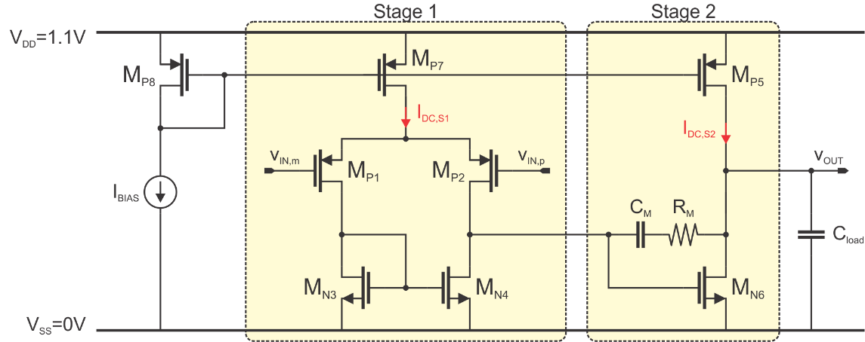
Final project
Overview
2 sessions:
09.12.2020 (today)
16.12.2020
2 Goals:
Design of a 2 stage miller compensated OTA
Fill out the “Design Project Report”
deadline: 2 weeks before oral exam
Quality of your report will impact on your final grade of this class
the better your report, the better your grade
not delivering the report before deadline or giving an empty report will lead to failure of this class!
Deadline for the report: 14/01/2022

Slide 3
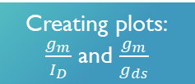
You are the researcher now!
cycle of how to conduct research in general
Creating plots: $\frac{g_{m}}{I_{D}}$ and $\frac{g_{m}}{g_{ds}}$
Goal
Plan
Simulate/ (Measure)
Conclusion
Here: Design of a 2 stage miller compensated OTA
Design on paper
Implement design in MATLAB and LTSpice
Here:
What is the cause of deviations between hand calculated and simulated results?
Here: in MATLAB and LTSpice

Slide 4
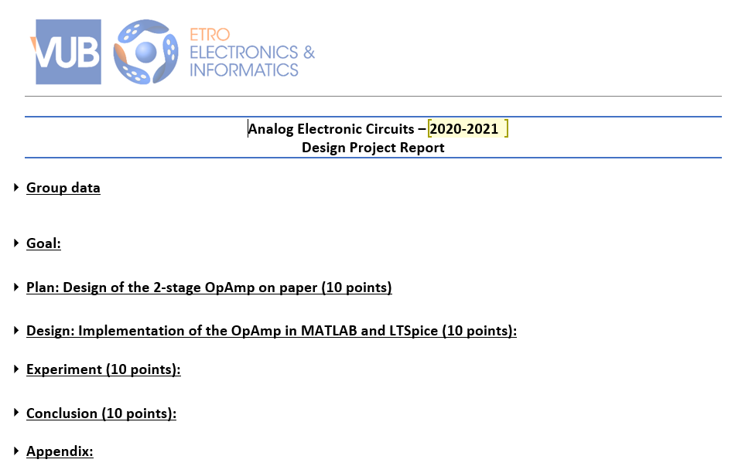
Final project
Overview of today’s session
Your goal for today till next week
Your goal from next week till deadline
each section gives 10 points
How to fill the report?
Just the yellow fields are editable
Follow the instructions listed in this report
Hints and remarks help you to speed-up your design progress
➔ Focus on having a working MATLAB-code today! Ask the TA’s for help

Slide 5
Final project
Overview of the coming slides
Content of the “Design Project Report”
LTspice guidelines
Organization of this and next session
Erratum

Slide 6
Content of the “Design Project Report”

Slide 7
Design Project Report
In the following each section is briefly discussed

Slide 8
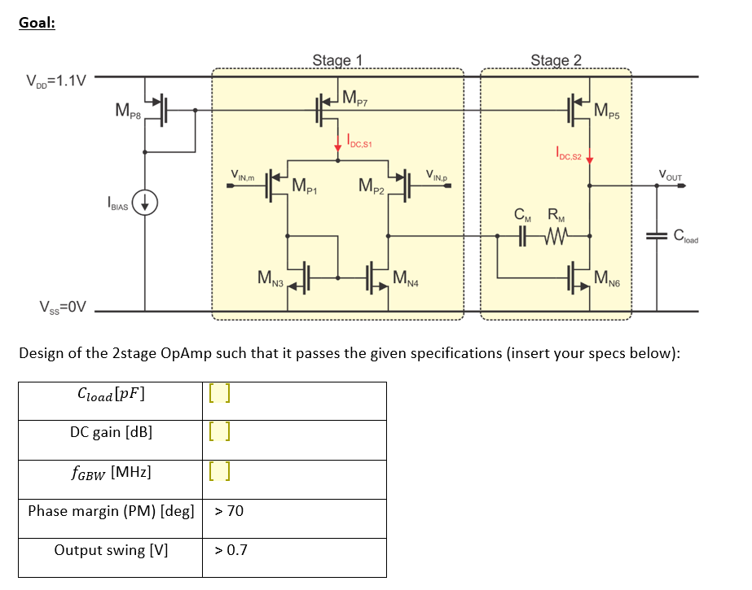
Design Project Report
Setup your goals by inserting your specification

Slide 9
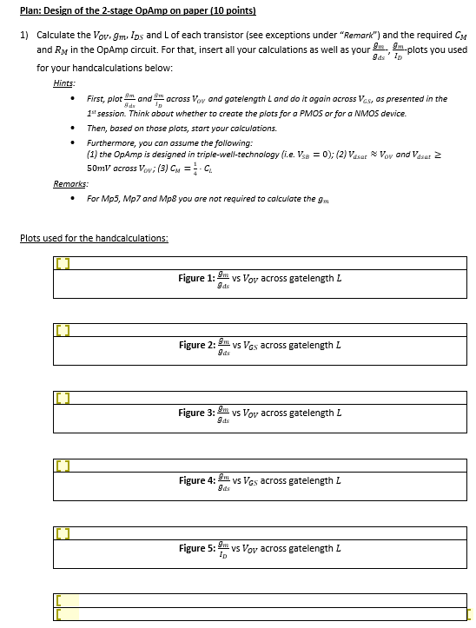
Design Project Report
Design on paper (1)
Create your plots, as presented during 1st session
Write down all your equations you used to calculate the small signal parameters step-by-step
All Transistors must be in saturation !

Slide 10
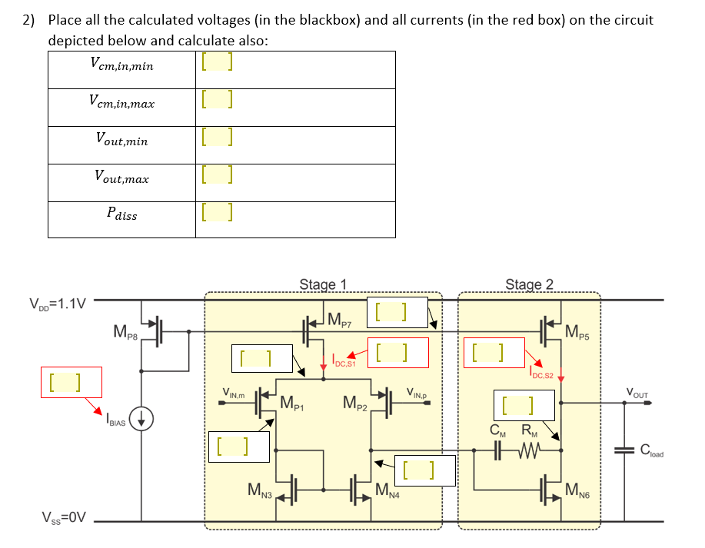
Design Project Report
Design on paper (2)
not just numbers, but give also the entire equation

Slide 11
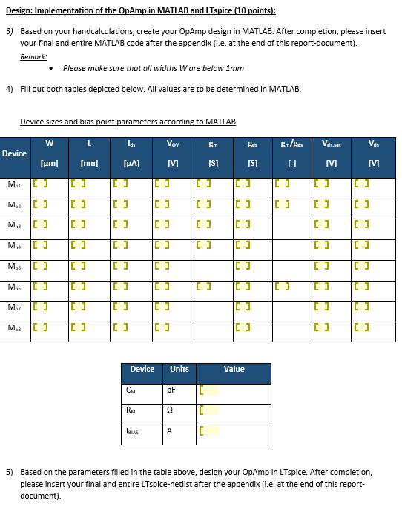
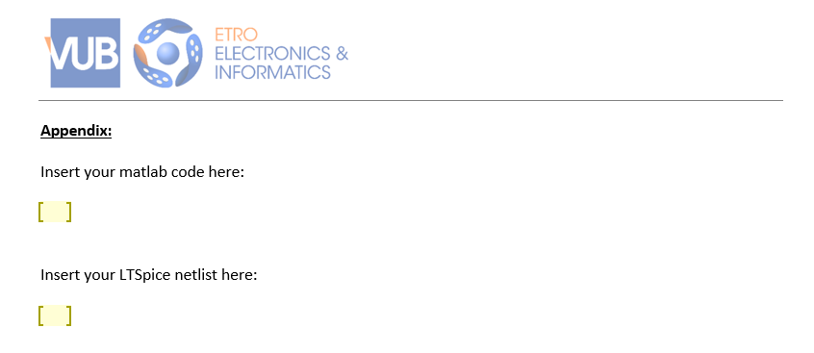
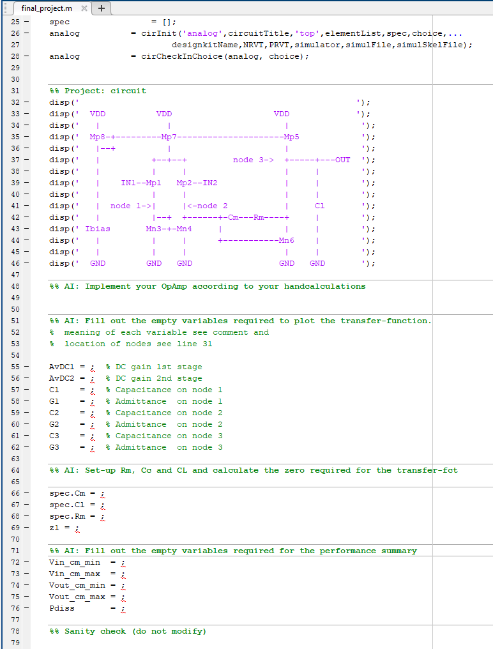
Design Project Report
Design
final_project.m
(on the last page of the report)
For those who have finished the code between this class and the next one
the other slides of this presentation show how to run the LTSpice simulations

Slide 12
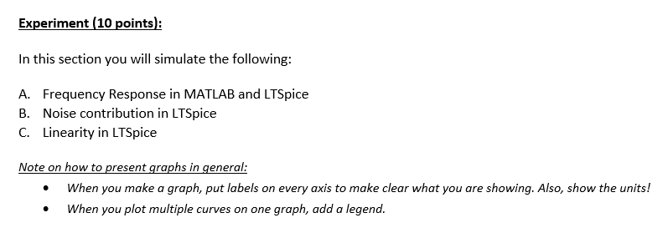
Design Project Report
Experiment
Further details about each experiment is explained in the report
Ask TAs for help, if instructions are not clear
After each simulation you are asked to “Explain, analyse and interpret”
This shows us that you understand each experiment!
How to explain, analyse and interpret?
Ask questions like
what do the results clearly indicate?
What have you found?
Then, find logical explanations for these results

Slide 13
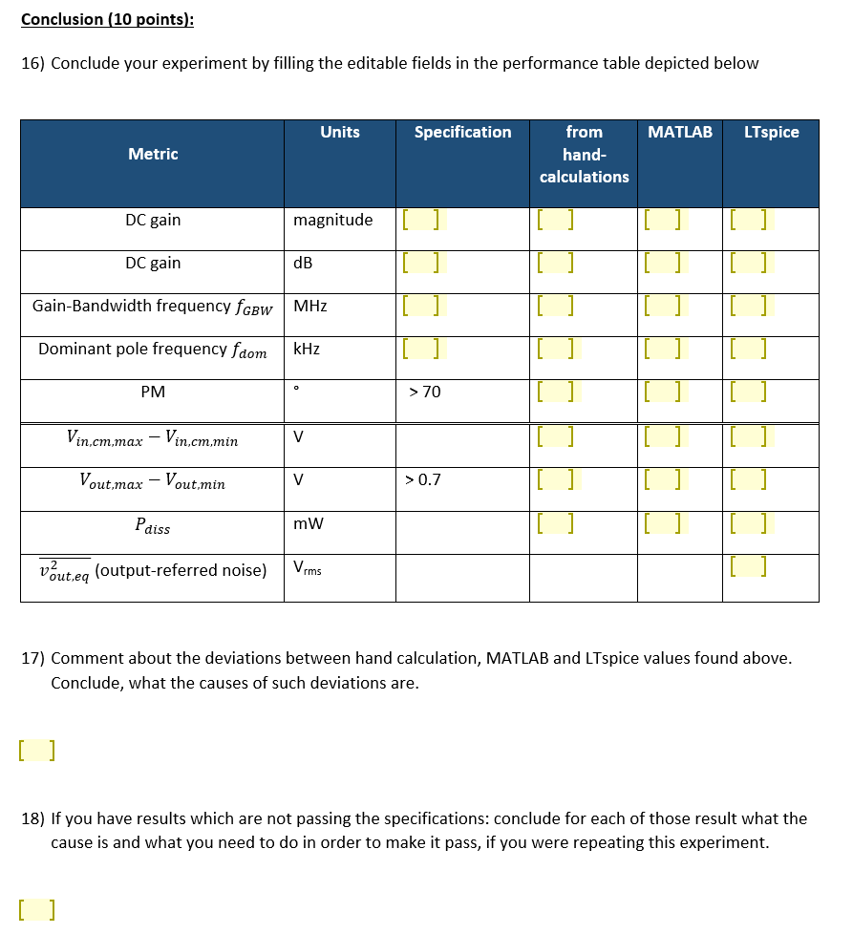
Design Project Report
from section “Plan: Design of the 2-stage OpAmp on paper”
Conclusion
calculate it
This summarizes your research!
Prove that you understand, from where the deviations are coming from
from section “Experiment”
If you are passing all the specs, you can leave this section empty

Slide 14
LTspice guidelines

Slide 15
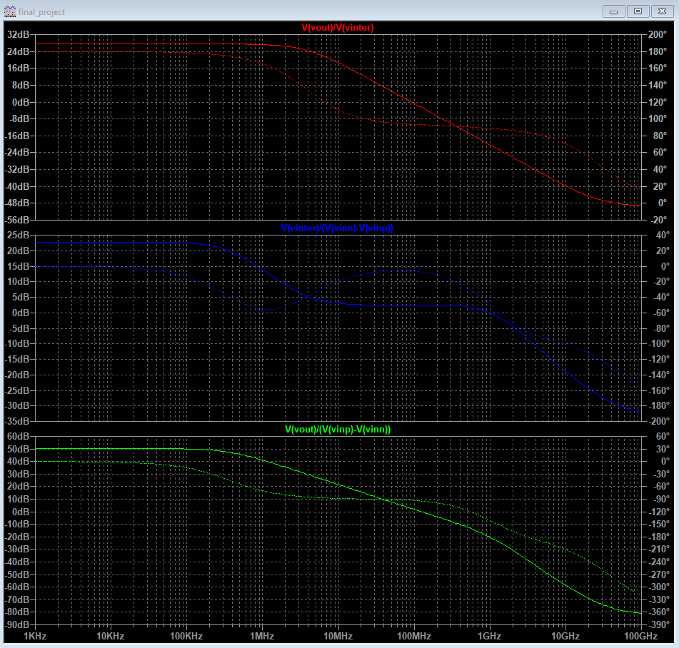
LTSPICE
AC plot
Use the file “final_project”
Change the transistors W and L with your calculated W and L
Change the VCM DC voltage to your desired VCM
Change IBIAS to your calculated bias current
Change the values of CLOAD to what was given to you and CM and RM to what you calculated
Run
Gain from the 2nd stage to the output
Gain from the 1st stage to the input of the 2nd stage
DC gain
Gain from the OTA

Slide 16
LTSPICE
AC plot
GBW
DC gain (V/V) x 1st pole (Hz)
Assuming a 1 pole system
1st pole is the frequency where phase is 45
1st pole is where the DC gain fall by 3dB
Sanity check: GBW is approximately the frequency @ 0dB (unity gain frequency)
Gain from the 2nd stage to the output
Gain from the 1st stage to the input of the 2nd stage
“GBW”
DC gain
Gain from the OTA
1st pole

Slide 17
LTSPICE
AC plot
Phase margin
Phase difference between the output phase at the 0dB gain frequency and 180 degrees
Use the cursor to get a more precise value (right-click in the graph name and change cursor from “None” to “1st”)
Gain from the 2nd stage to the output
Gain from the 1st stage to the input of the 2nd stage
Output phase @ 0dB
Phase margin
DC gain
Gain from the OTA

Slide 18
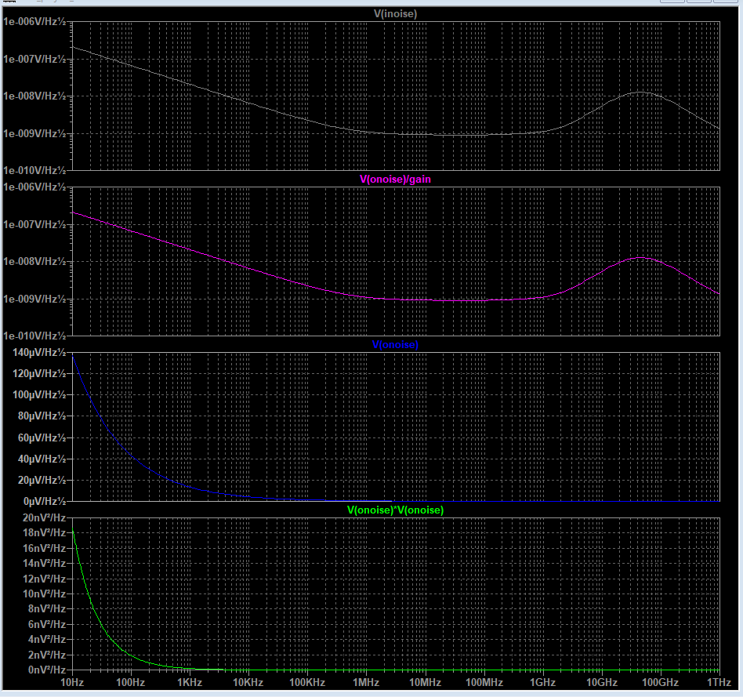
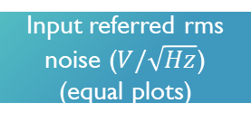
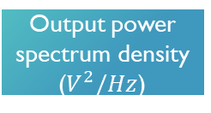
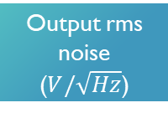
LTSPICE
Noise
Use the file “final_project_noise”
Change the transistors W, L, VCM, CLOAD, CM, RM, IBIAS the same way as done before
Run
Input referred rms noise ($V/\sqrt{Hz}$) (equal plots)
Output rms noise ($V/\sqrt{Hz}$)
Output power spectrum density ($V^{2}/Hz$)

Slide 19
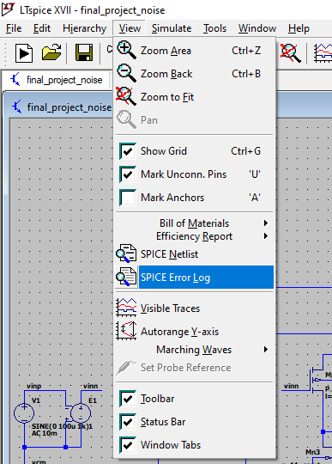
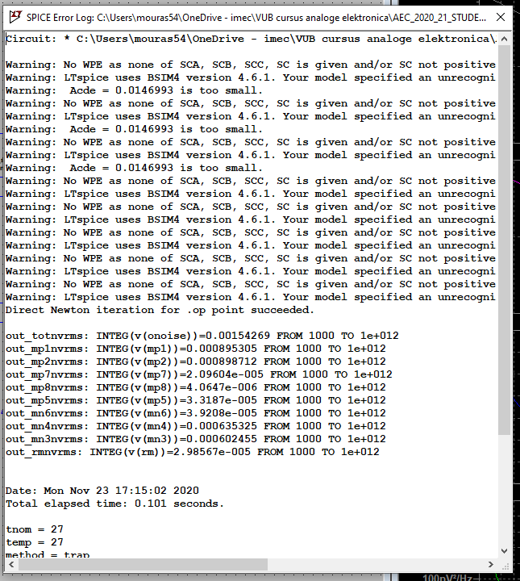
LTSPICE
Noise
Use the file “final_project_noise”
To print the integrated noise power contribution of each element at the output, use the command shown in the figure
The tab “View” with these options only appears when the circuit window is selected
The first line is the total output referred noise in Vrms which you need for your report

Slide 20
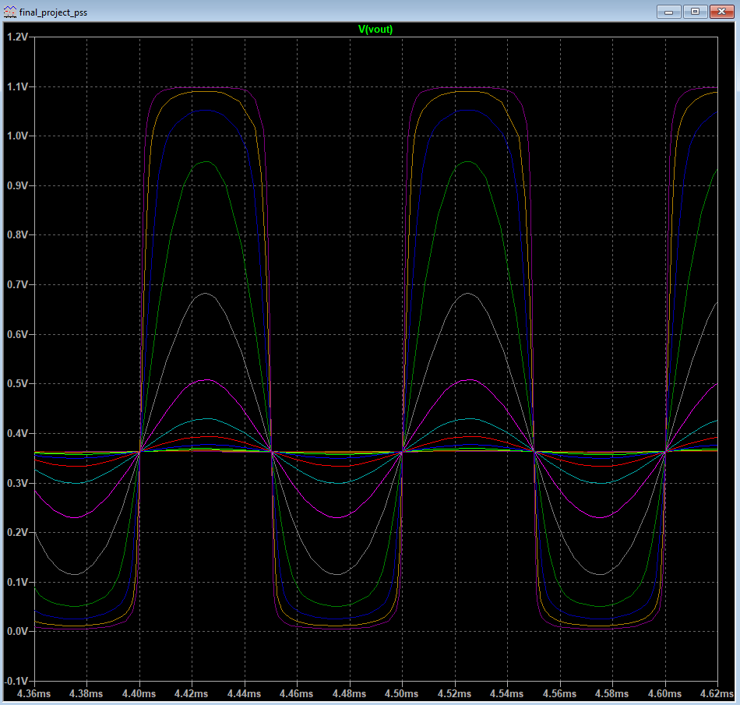
LTSPICE
Waveforms at the output starts compressing
Compression
Use the file “final_project_pss”
Change the W, L, VCM, CLOAD, CM, RM, IBIAS the same way as done before
Run (it may take some seconds to finish)

Slide 21
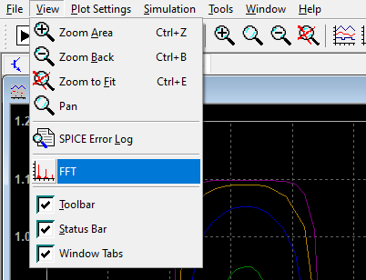
LTSPICE
Compression
Use the file “final_project_pss”
With the plot window selected, choose the tab View -> FFT

Slide 22
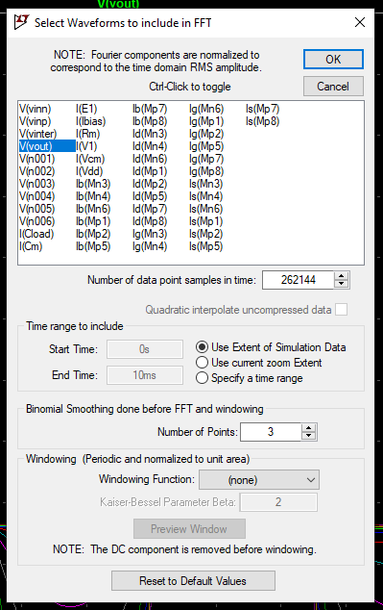
LTSPICE
Compression
Use the file “final_project_pss”
Select “V(vout)”, leave the settings as it is and press “OK” (it may take some seconds to plot)

Slide 23
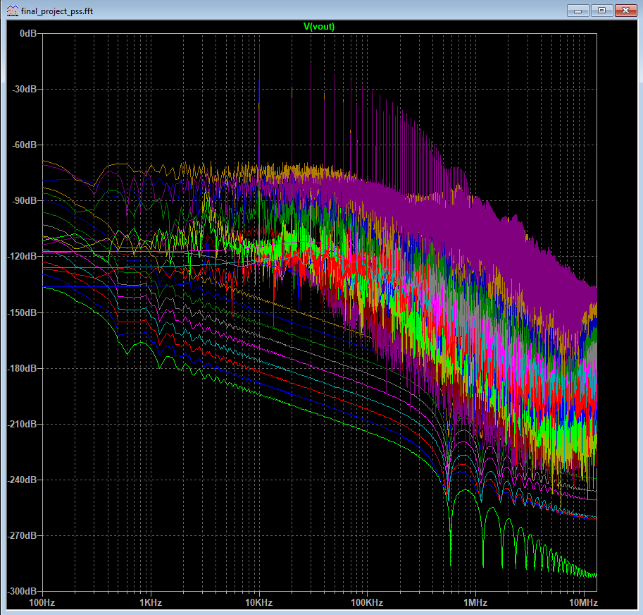
LTSPICE
Compression
Use the file “final_project_pss”
The Fourier Transform of the output signal is done for different amplitude signals

Slide 24
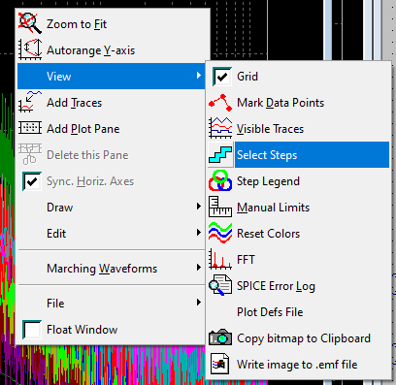
LTSPICE
Compression
Use the file “final_project_pss”
You can “Right-click” on the graph and filter by amplitude using “Select Steps”

Slide 25
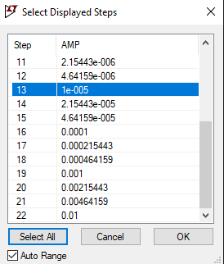
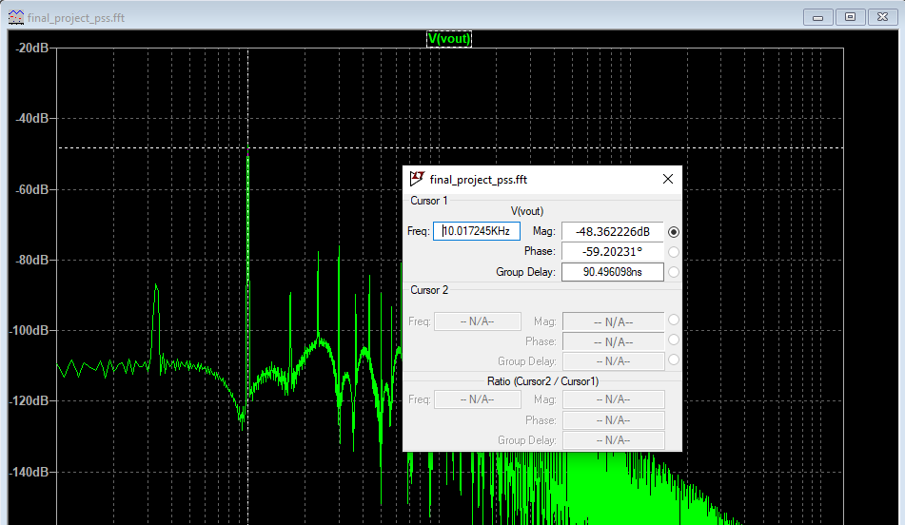
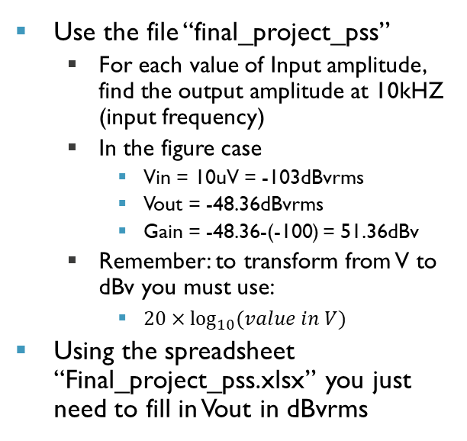
LTSPICE
Compression
Use the file “final_project_pss”
For each value of Input amplitude, find the output amplitude at 10kHZ (input frequency)
In the figure case
Vin = 10uV = -103dBvrms
Vout = -48.36dBvrms
Gain = -48.36-(-100) = 51.36dBv
Remember: to transform from V to dBv you must use:
$20×\log_{10}{(value in V)}$
Using the spreadsheet “Final_project_pss.xlsx” you just need to fill in Vout in dBvrms

Slide 26



LTSPICE
Compression
$$V_{out}$$
Plot the compression graphs
Vout (V) x Vin (V) in a log-log scale
Gain (dB) x Vin (V) in a semi-log scale
Retrieve 1dB compression point:
Vin value at which the Vout falls by 1dB from the trendline
$$V_{in}$$
$$Gain$$
$$V_{in}$$

Slide 27
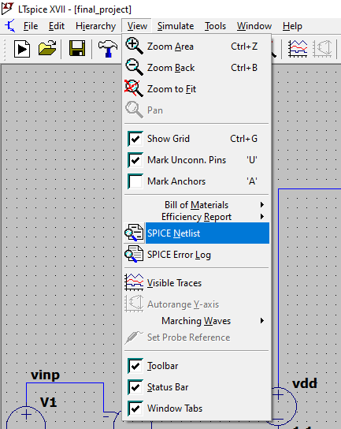
LTSPICE
Exporting the Netlist
On any LTSpice file after you fill in with the transistor values you found, you can export the netlist following the command in the picture

Slide 28
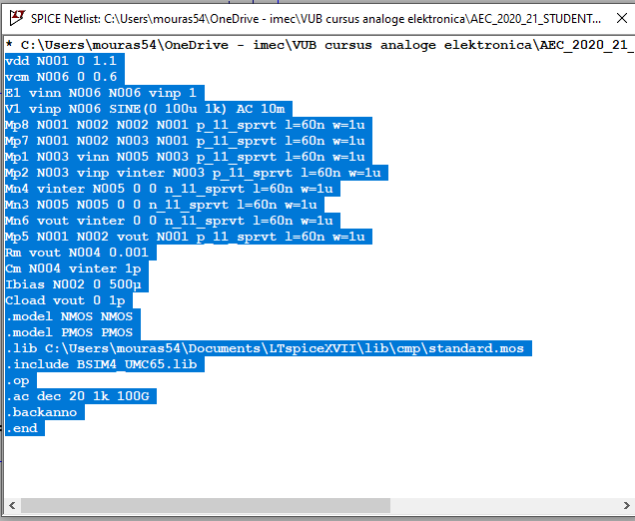
LTSPICE
Exporting the Netlist
Copy and paste the pop-up window in the specific part of your report

Slide 29
Organization of this and next session

Slide 30
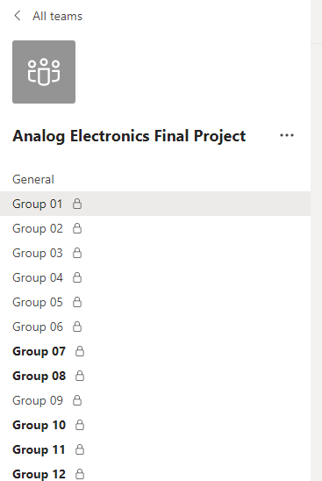
Organization of this and next session
Leave the meeting in the general channel.
Start a new meeting in the channel with your group number.
Start designing your OTA in collaboration with your partner within the channel.
If you need help, state that you have a question in the chat of the general channel.
Example: “We have a question regarding the noise of OTA, Group 2.”
Afterwards, one of the TAs will join to your meeting to help.

